Slide 1
CS626: Project Discussion
Common Sense Validation
Abisek R K, 21Q050004
Tejpal, 21Q050008
Naveen, 213050052
27th November, 2021

Slide 2
Motivation
Common sense Validation is one of the main challenges of Natural Language Understanding and Natural Language Generation.
It is easier for humans to distinguish between a logical sentence and a sentence that doesn’t makes sense, but it is difficult for a model to learn the same.
The common sense score can be used as a metric in evaluating the quality of statements generated by models.

Slide 3
Problem Statement
Given a sentence, predict the common sense score indicating how much a sentence is meaningful in real world.
Input : A sentence.
Output : A common sense score with label which indicates whether the sentence makes sense or is against common sense.

Slide 4
Supporting Papers (Literature survey)
Cunxiang Wang, Shuailong Liang, Yili Jin, Yilong Wang, Xiaodan Zhu, Yue Zhang, Commonsense Validation and Explanation, SemEval-2020.
The Paper that announced the task.
Yice Zhang, Jiaxuan Lin, Yang Fan, Peng Jin, Yuanchao Liu, Bingquan Liu, Enhanced Language Representation with Multiple Knowledge Triples, SemEval-2020.
An approach which uses Knowledge Graph (conceptnet) with BERT.

Slide 5
Supporting Papers (Literature survey)
Heba Al-Jarrah, Rahaf Al-Hammouri, Mohammad AL-Smadi, The impact of RoBERTa transformer for evaluation common sense understanding, SemEval-2020.
Using RoBERTa for common sense classification.
Sirwe Saeedi, Aliakbar Panah, Seyran Saeedi, Alvis C Fong, Evaluation of State-of-the-art NLP Deep Learning Architectures on Commonsense Reasoning Task, SemEval-2020.
Using ALBERT, XLNET for common sense classification.

Slide 6
Data (1)
We are using the dataset released as a part of the SemEval 2020 Task 4 - Commonsense Validation and Explanation.
Each instance in the dataset is composed of 8 sentences
2 sentences, one that makes sense and one against it.
3 sentences, optionally explain the against common-sense sentence.
3 sentences, reason about the against common-sense sentence
10,000 Training instances, 1000 Development and 1000 Test instances.

Slide 7
Data (2)
Dataset Instance Example - common sense & against sense statements:
He put a turkey into the fridge
He put an elephant into the fridge
Optional explanation sentences for against sense:
An elephant is much bigger than a fridge
Elephants are usually white while fridges are usually white.
An elephant cannot eat a fridge
Referential sentences for against sense:
An elephant is much bigger than a fridge.
A fridge is much smaller than an elephant.
Most of the fridges aren’t large enough to contain an elephant.

Slide 8
Main Technique
Approach:
We took our common sense validation as classification task in two approaches:
Single sentence models - Predict a common sense score for a single sentence.
Sentence Pair models - Given a pair of sentences, predict a score of the first/ second sentence representing common sense.
Main Contribution:
Common sense validation was not done for single sentence before.
A score is predicted for sentence/ sentence pairs instead of just the label, providing more insights about the sentences.

Slide 9
Techniques Used
K-BERT
Cosine Similarity of Word Embeddings
S-BERT
BERT
ALBERT
RoBERTa
XLNET

Slide 10
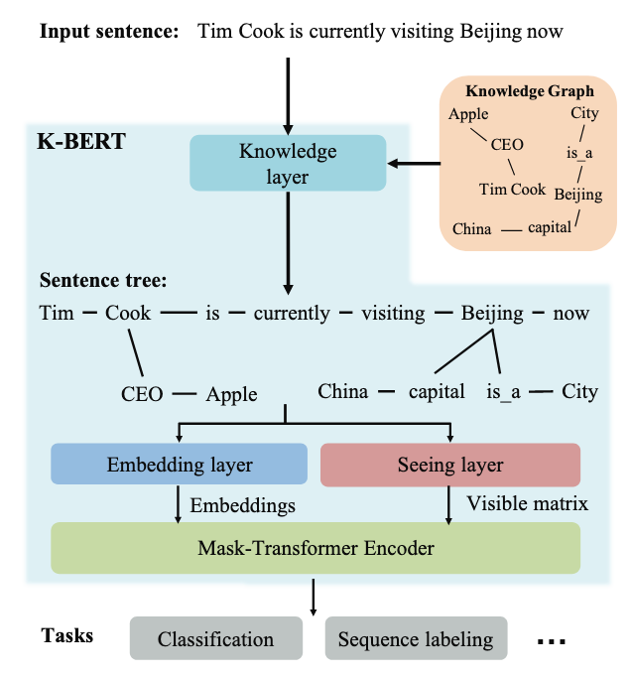
K- BERT
Conceptnet was used as the knowledge graph.
For each word in the input sentence, common sense knowledge was injected as triplets and a BERT model was trained on knowledge injected triplets.

Slide 11
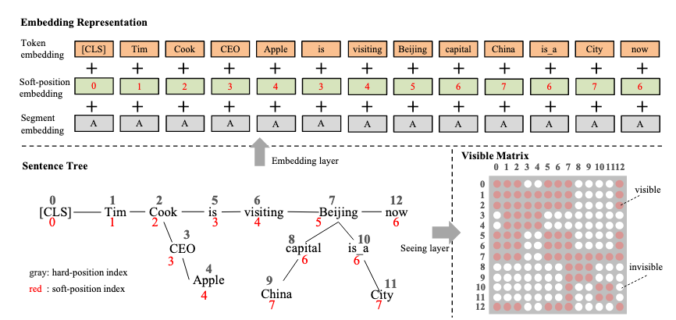
K- BERT

Slide 12
Cosine Similarity of Word Embeddings
Word embeddings of each word in the sentences is compared with all other words in the sentence using cosine similarity.
We average out the cosine similarities among the words to get a metric for the whole sentence.
We compare the averaged cosine similarities of the two sentences and assign the common sense tag to the one with the highest value.

Slide 13
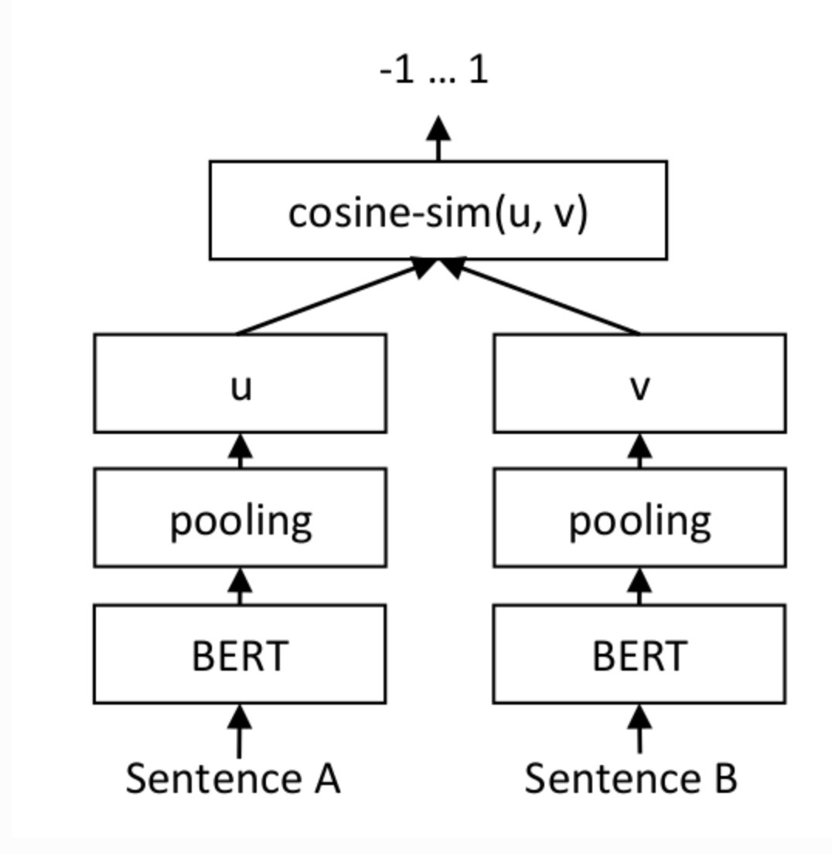
S- BERT
A model is trained to discriminate sentences with common sense and against common sense by training them with their cosine similarity to be 0.
Also the model is trained to learn the correlation between common sense sentences and the reasons why that sentence represents common sense by training the permutations of their pairs with cosine similarity to be 1.

Slide 14
Technique For Other Bert Models
Single Sentence :
Semeval Commonsense dataset is transformed with each sentence having the label 0 (makes sense) and 1 (makes no sense)
The pretrained model is trained using the transformed dataset to help make predictions on new unseen data.
2. Two sentences :
Semeval Commonsense dataset containing two sentences and a label with 0 and 1 indicating makes sense or makes no sense respectively is used.
The two sentences are combined to form a single sentence.
The pretrained model is trained using the above modified dataset to help make predictions.

Slide 15
Models Used
BERT
RoBERTa
XLNet
ALBERT

Slide 16
Results - Single Sentence (1)
 | ALBERT |  |  | RoBERTa |  |  | BERT
 | Precision | Recall | F1 | Precision | Recall | F1 | Precision | Recall | F1
CS | 0.9859 | 0.9817 | 0.9838 | 0.00 | 0.00 | 0.00 | 0.9350 | 0.9684 | 0.9514
N-CS | 0.9811 | 0.9854 | 0.9833 | 0.4907 | 1.00 | 0.6583 | 0.9660 | 0.9302 | 0.9477
Overall | 0.9835 | 0.9835 | 0.9835 | 0.4907 | 0.4907 | 0.4907 | 0.9497 | 0.9497 | 0.9497
CS - Common Sense N-CS - Doesn’t make Sense

Slide 17
Results - Single Sentence (2)
 | XLNET |  |  | S-BERT
 | Precision | Recall | F1 | Precision | Recall | F1
CS | 0.8876 | 0.9642 | 0.9189 | 0.892365 | 0.7130 | 0.792663
N-CS | 0.9587 | 0.8604 | 0.9069 | 0.761032 | 0.9140 | 0.830532
Overall | 0.9133 | 0.9133 | 0.9133 | 0.813500 | 0.8135 | 0.8135
CS - Common Sense N-CS - Doesn’t make Sense

Slide 18
Results - Sentence Pairs (1)
 | ALBERT |  |  | RoBERTa |  |  | BERT
 | Precision | Recall | F1 | Precision | Recall | F1 | Precision | Recall | F1
CS | 0.9926 | 0.9955 | 0.9941 | 0.9941 | 0.9955 | 0.9948 | 0.7461 | 0.5014 | 0.5998
N-CS | 0.9958 | 0.9930 | 0.9944 | 0.9958 | 0.9944 | 0.9951 | 0.6412 | 0.8393 | 0.7270
Overall | 0.9942 | 0.9942 | 0.9942 | 0.9950 | 0.9950 | 0.9950 | 0.6754 | 0.6754 | 0.6754
CS - Common Sense N-CS - Doesn’t make Sense

Slide 19
Results - Sentence Pairs (2)
 | XLNET |  |  | S-BERT |  |  | Context Embeddings
 | Precision | Recall | F1 | Precision | Recall | F1 | Precision | Recall | F1
CS | 0.4850 | 1.00 | 0.6532 | 0.786062 | 0.970 | 0.868397 | 0.5138 | 0.4926 | 0.5030
N-CS | 0.00 | 0.00 | 0.00 | 0.960836 | 0.736 | 0.833522 | 0.5400 | 0.5609 | 0.5502
Overall | 0.4850 | 0.4850 | 0.4850 | 0.853 | 0.853 | 0.853 | 0.5278 | 0.5278 | 0.5278
CS - Common Sense N-CS - Doesn’t make Sense

Slide 20
Analysis - Correct Predictions
Video game consoles can be seen without contact lenses only
The sentence meaning is ambiguous.
The refrigerator cleaned the dirty clothes
Need knowledge about refrigerator and what it stores and does.
She threw the football to the batter
Needs knowledge about the size of the football and bat in general.
It's important to skip school to get good grades
Identifies the deep meaning.

Slide 21
Analysis - Misclassifications
I put the leftover food in the oven.
Food in the oven - Makes sense
I put the leftover food somewhere - Makes sense
But together they don’t make sense. Our models were still able to predict it correctly, but with less confidence.
A cat dropped from a plane wearing a parachute will land on the tip of its' tail.
There is so much information in the sentence which leads to confusion.
A war is fought for solution
This sentence can be viewed differently based on the context it occured. So classifying it either way is debatable, and our models predicted both classes equally.

Slide 22
Conclusion
Developed a system to predict a common sense score for a given sentence/ sentence pairs.
Explored various DLNLP Techniques to solve this specified task.
The models performed very well except in cases where the sentence has complex context information or unknown contexts.
This work can be further extended to Common-sense reasoning i.e providing explanation sentences why a particular sentence is against common-sense

Slide 23
Demo

